Slide 2
Section 7 Sequences, Series and Proof by Induction
Sequences
Series
Proof by Induction

Slide 3
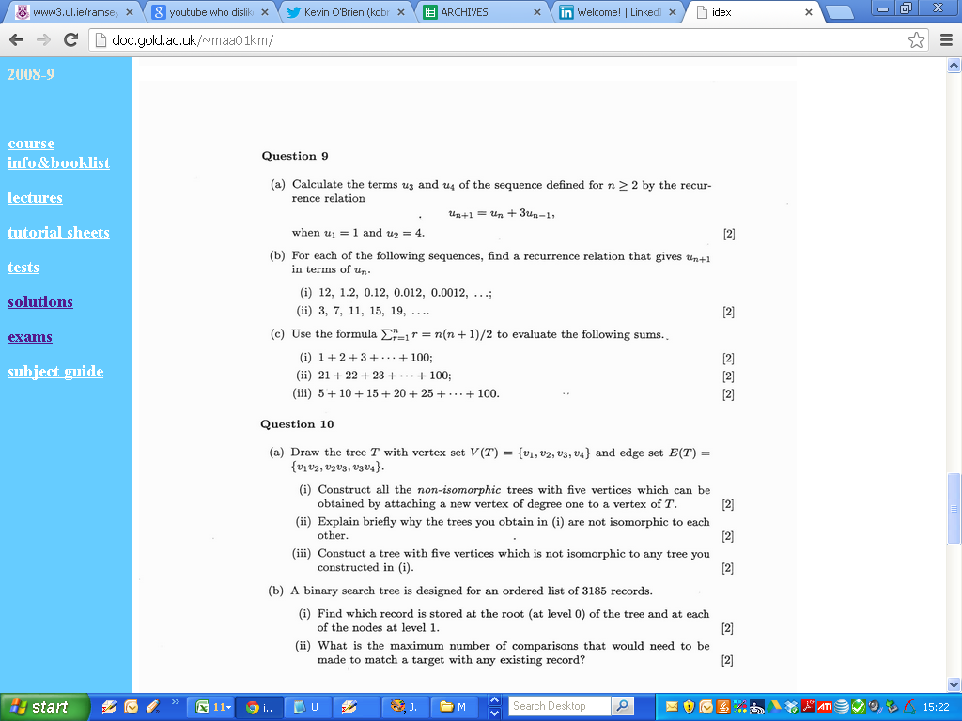
2001

Slide 5
2001

Slide 7
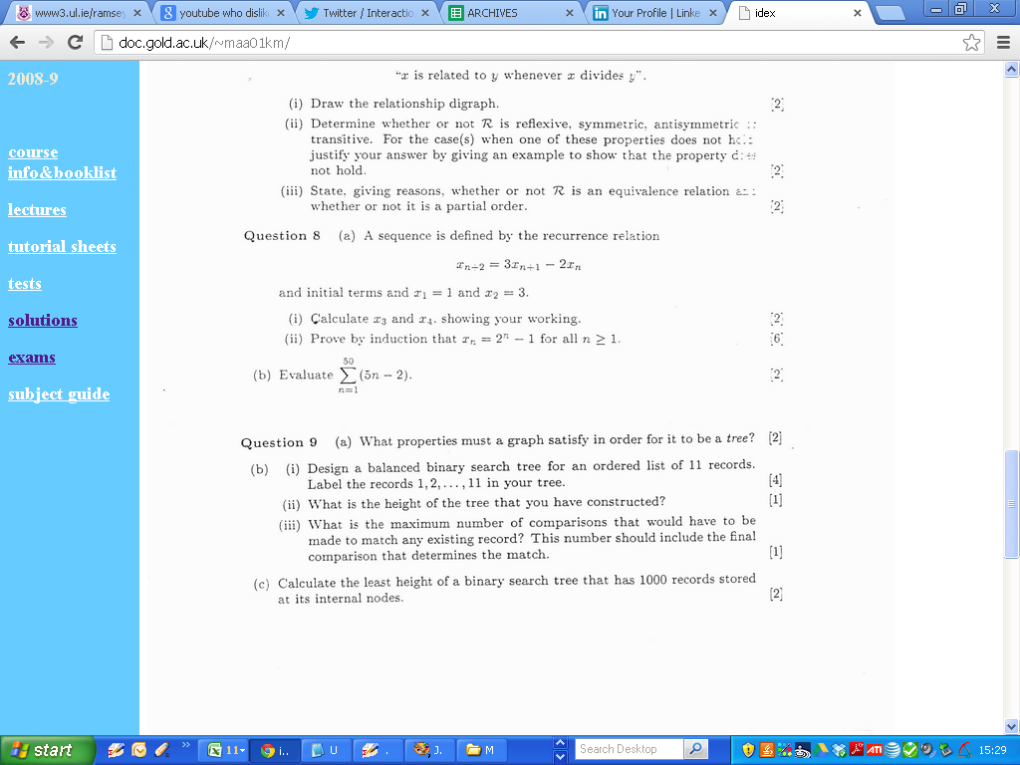
2002

Slide 8
2001

Slide 11
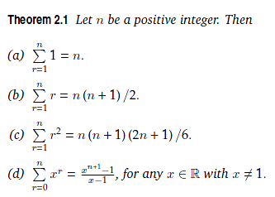
Section 7 Sequences, Series and Proof by Induction
Series

Slide 12
2001

Slide 14
2001

Slide 15
2001

Slide 17
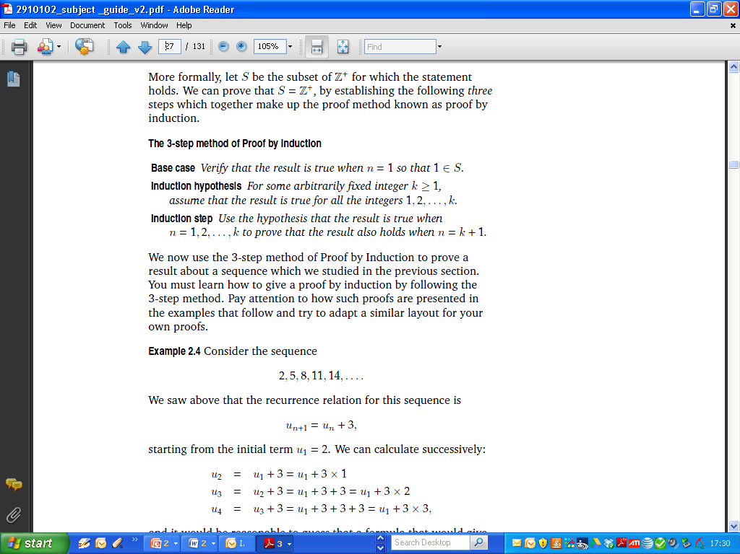
Section 7 Sequences, Series and Proof by Induction
Proof by Induction

Slide 18
2002

Slide 19
2002

Slide 20
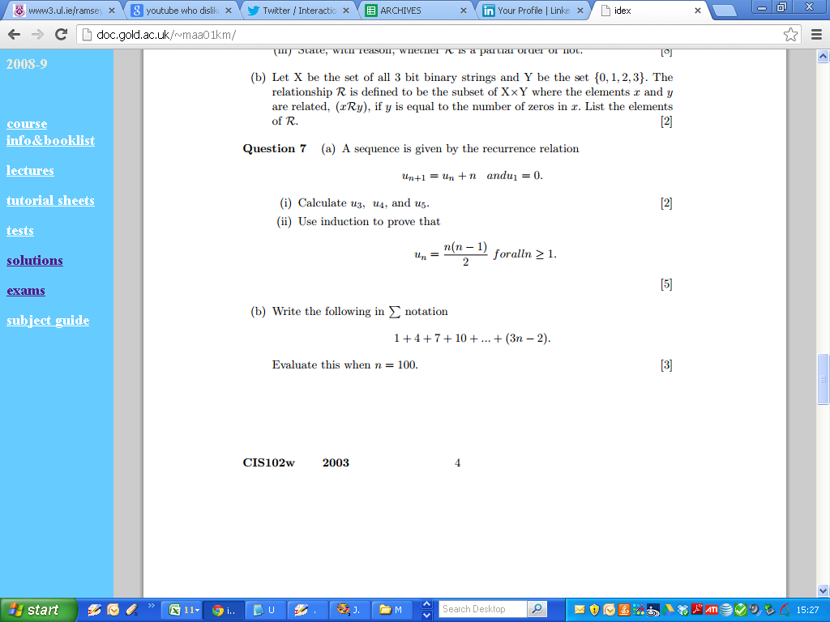
2003

Slide 21
2003

Slide 22
2003

Slide 23
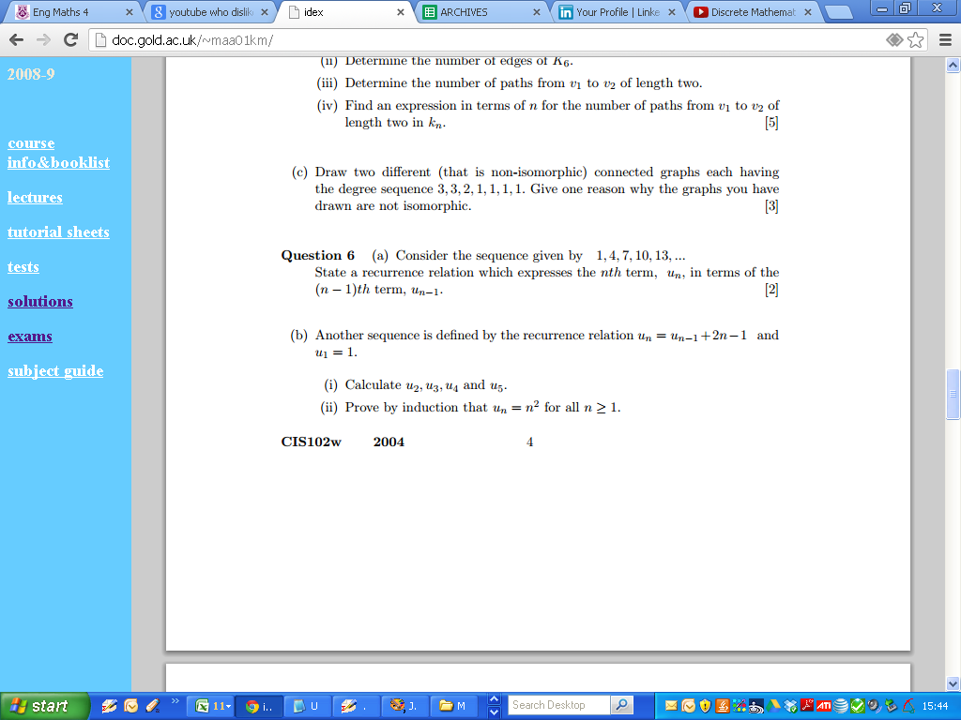
2004

Slide 24
2004

Slide 25
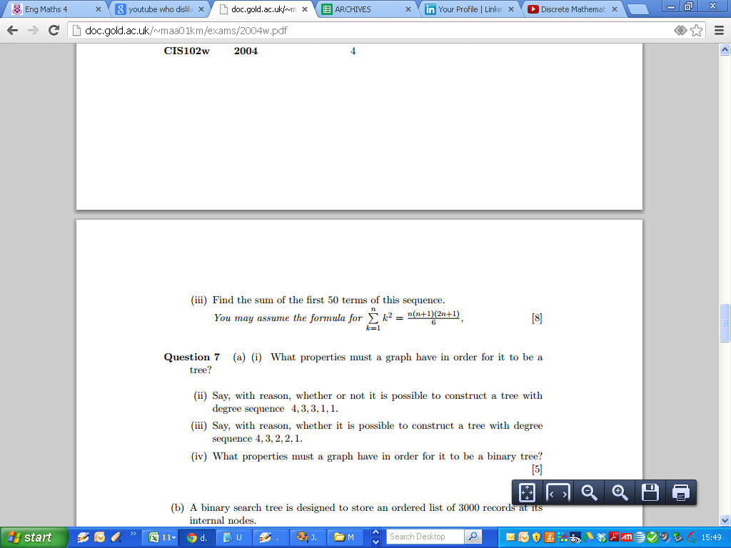
2004

Slide 26
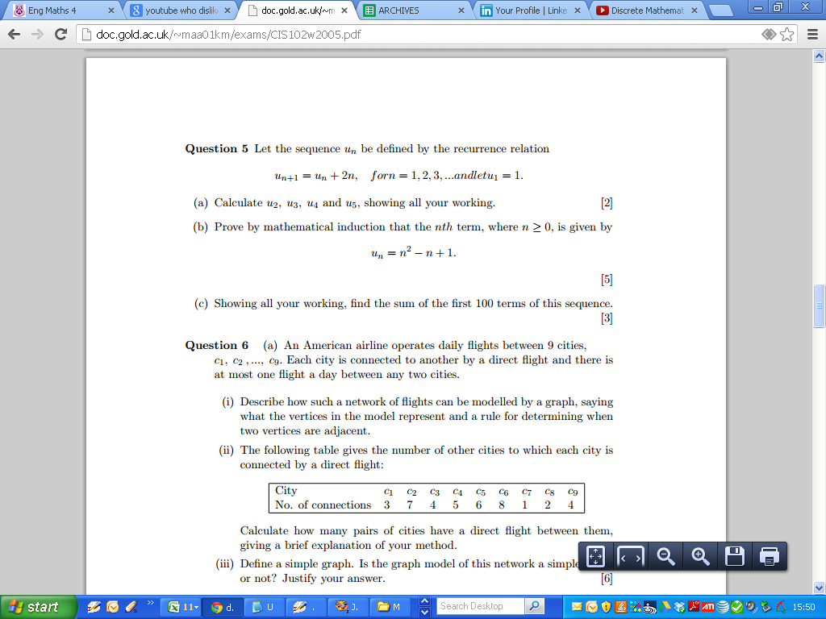
2005

Slide 27
2005

Slide 28
2005

Slide 29
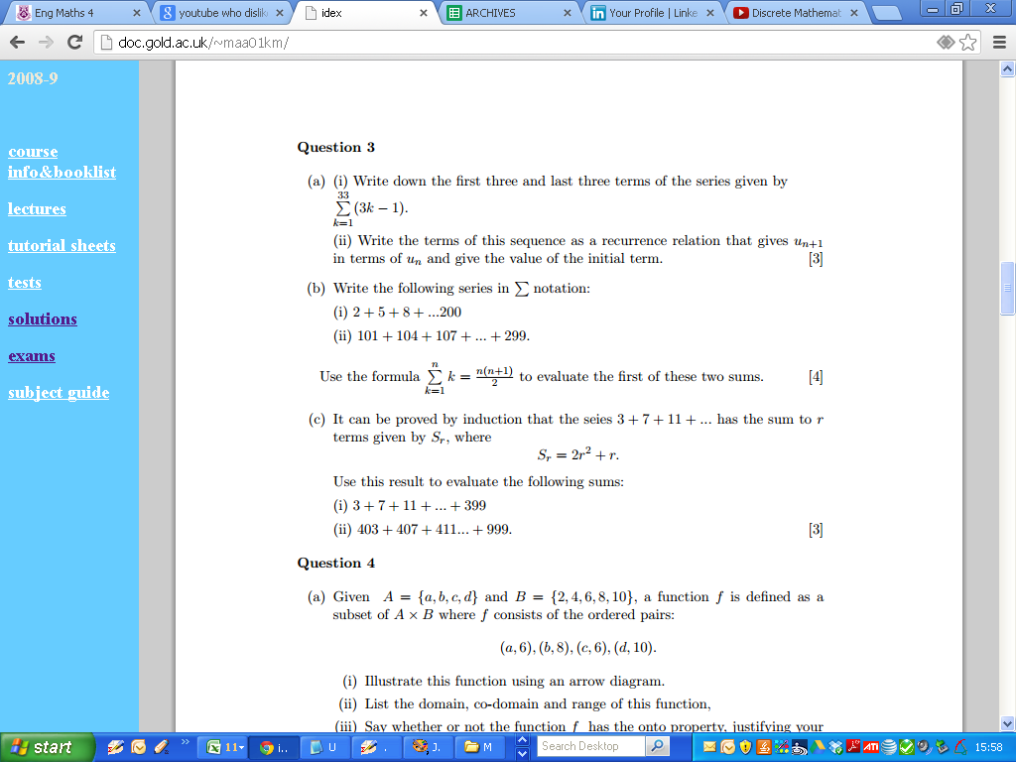
2006

Slide 30
2006

Slide 31
2006

